Slide 1



H.Yavuz ERZURUMLU
Software Engineer / ARDIÇ
yavuz.erzurumlu@ardictech.com
Developing IoT Applications using Raspberry Pi and Android Things
https://github.com/freeloki
Ceyhun ERTÜRK
Software Engineer / ARDIÇ
ceyhun.erturk@ardictech.com

Slide 2

What are we going to learn ?
What is IoT?
Why Android Things?
What is IoT-Ignite?
Demo Application
An Introduction to IoT Devices and Environment
How to setup a gateway

Slide 3
What are we going to learn ?
Practising IoT-Ignite apps on demo code
Making an application trusted
Configuration a gateway
Visualizing thing data on IoT-Ignite
Defining a complex event rule

Slide 4

What is IoT?

Slide 5
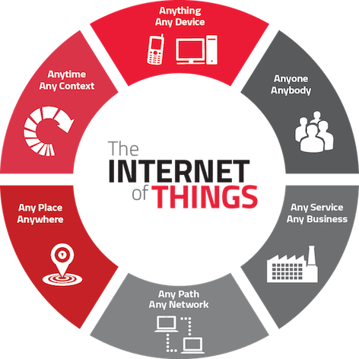
What is IoT?
IoT is an abbreviation for Internet of Things.
All devices around us can be managed locally or remotely by connecting them to the Internet in various ways. Even devices can manage others.
Notes:
IoT esprileri yap.
Sayısal verilerle olaya gir.

Slide 6
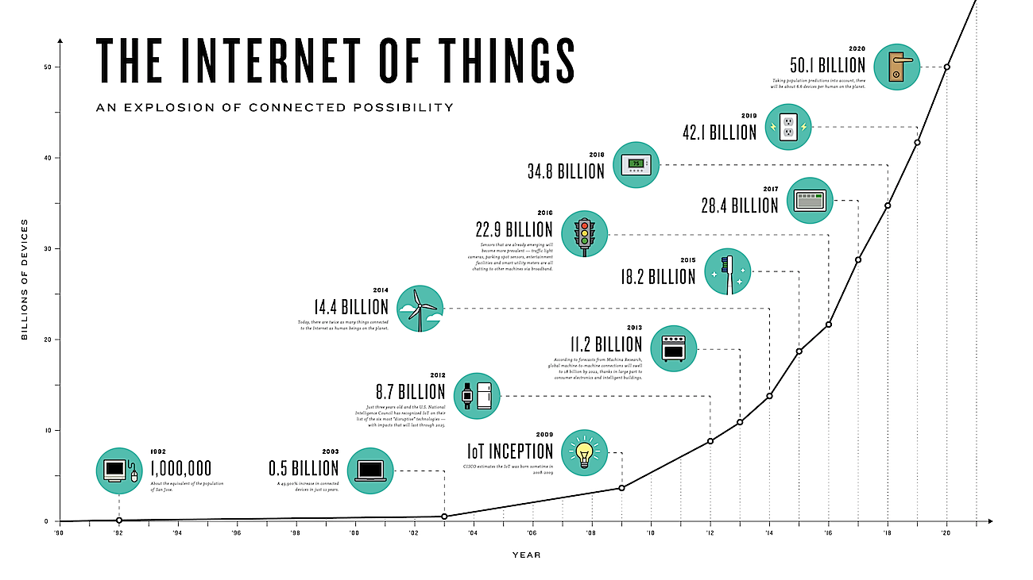

Slide 7
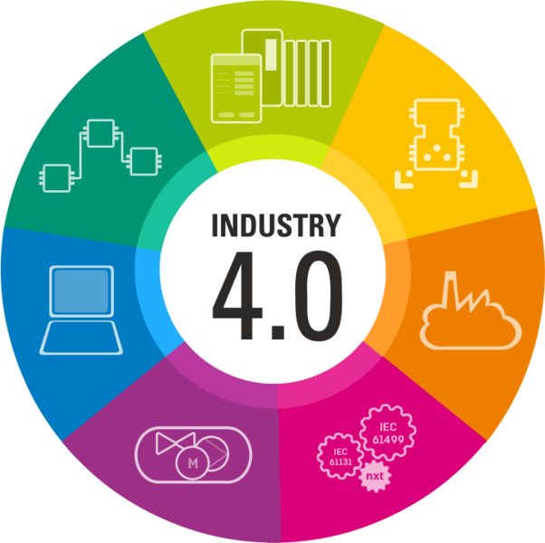

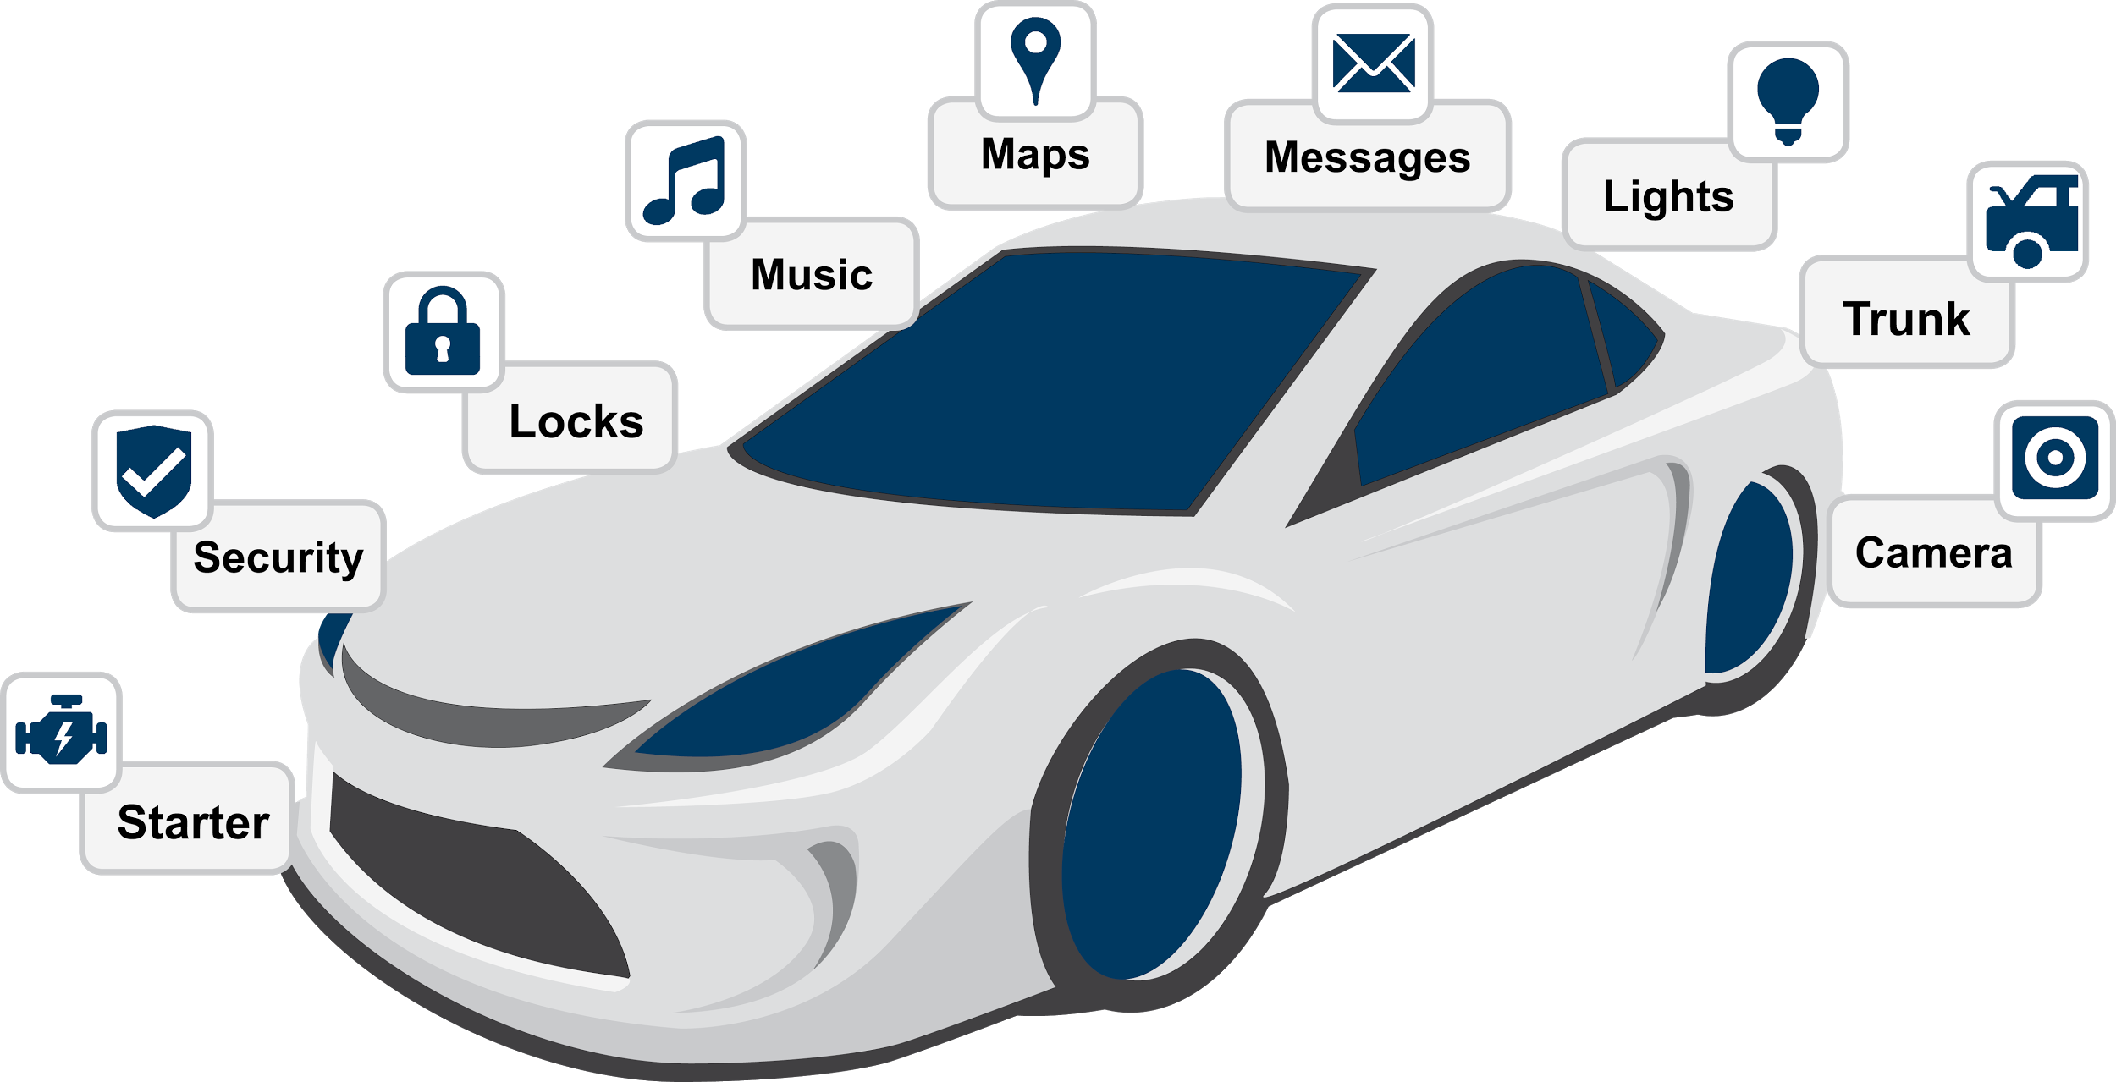
What are main IoT Application Areas?
Smart Homes
Industry 4.0
Smart Cities
Smart Agriculture
Medical Applications
Smart Cars
Notes:
Uygulama alanları ile ilgili resimleri koy.

Slide 8
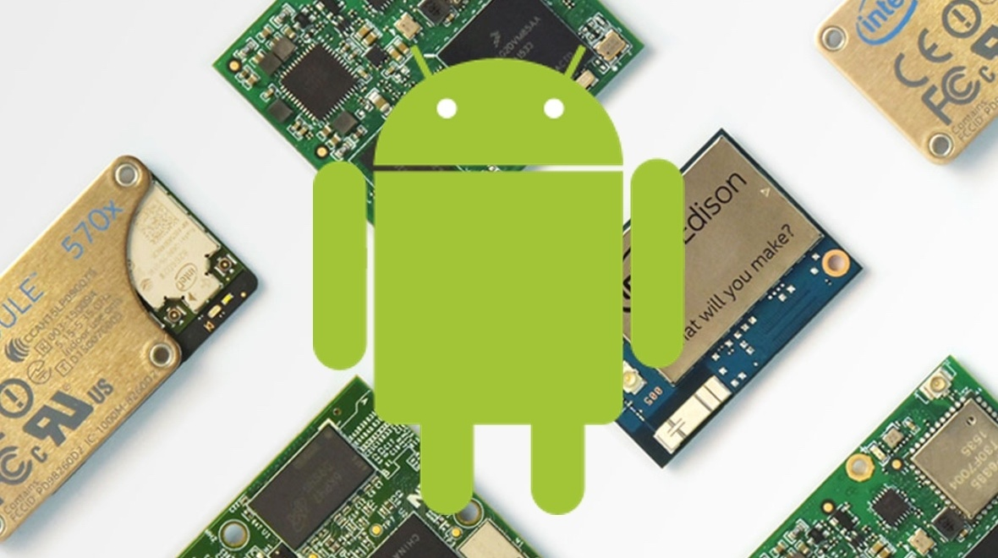

Android Things™
Google has developed the IoT version of Android OS, the most widely used operating system in the world, to run on embedded devices.
Announce Date: December 2016 (Dev preview 1)
https://developer.android.com/things/index.html
Notes:
Brillo ile gir.. Android cihaz sayısını koy. Google ve developer gücünden bahset.

Slide 9
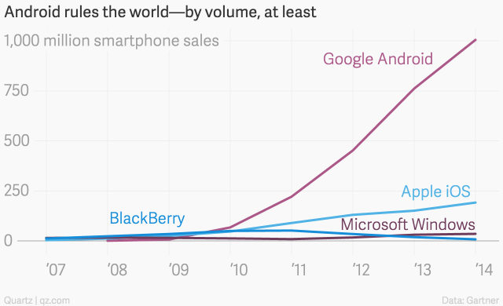

Slide 10
Advantages of Android Things
Easy programming;
You develop your IoT applications in the same way you develop a mobile application.
You have the complete functional support of an IDE: Android Studio.
It is free and open source (Source code will be published sooner).
It is secure.
Easy management.
Offically supported hardware
Platform with the largest developer community.
Notes:
android device monitör, layout tracking, thread tracking, awesome debug tools.

Slide 11
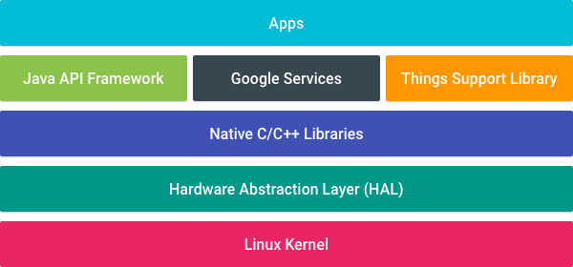
Android Things Architecture

Slide 12
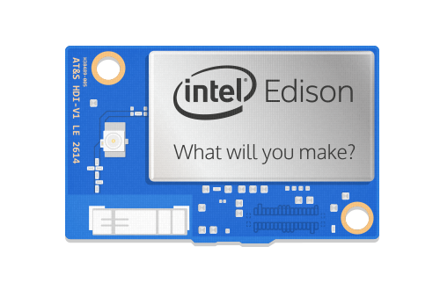
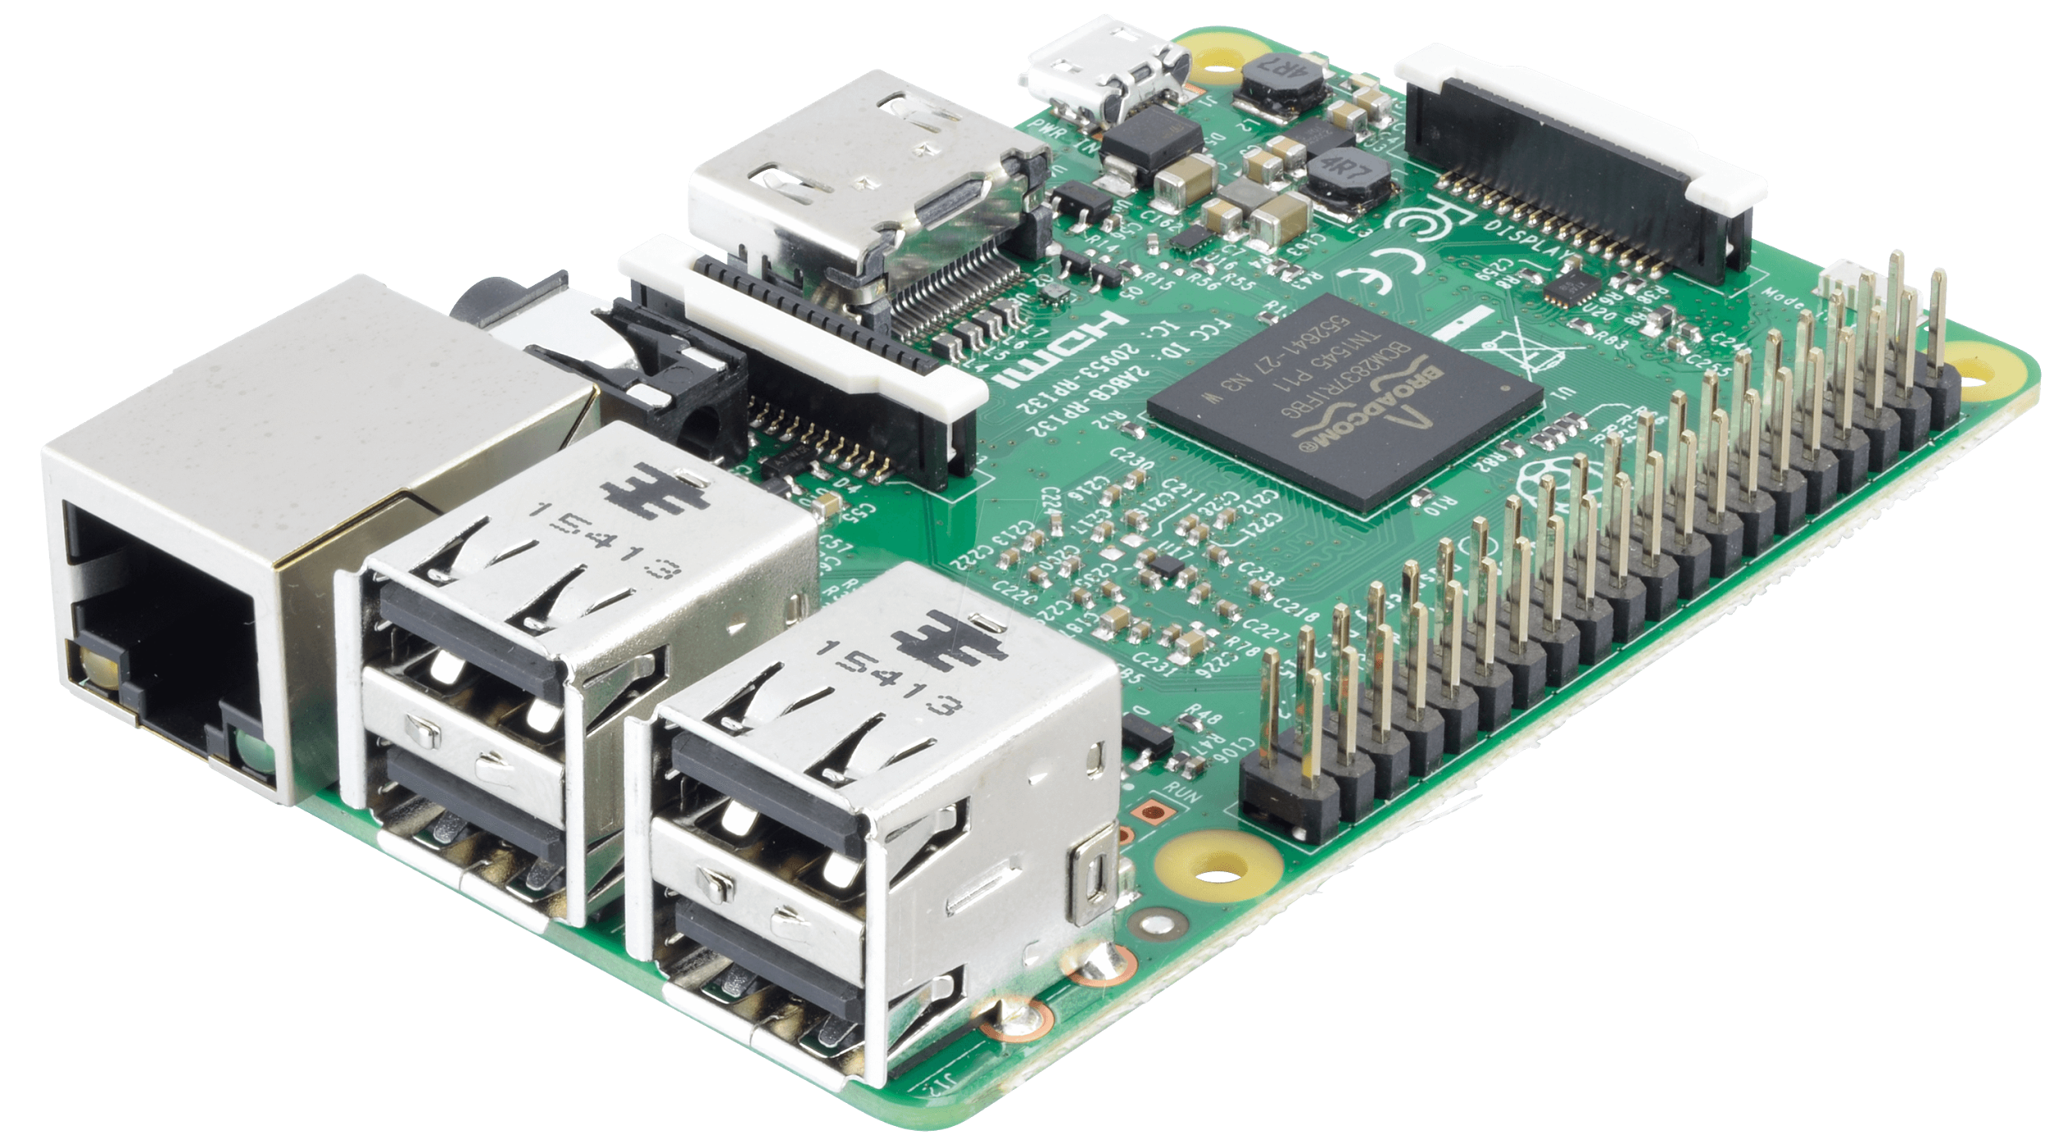
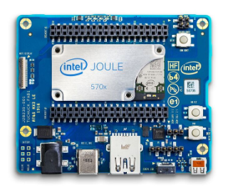
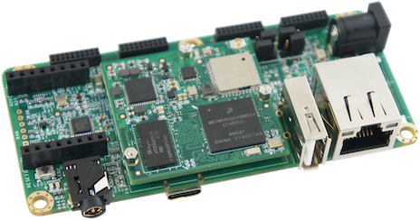
Supported Devices
Raspberry Pi 3 | Intel Edison
Intel Joule | NXP Pico i.MX6UL

Slide 13
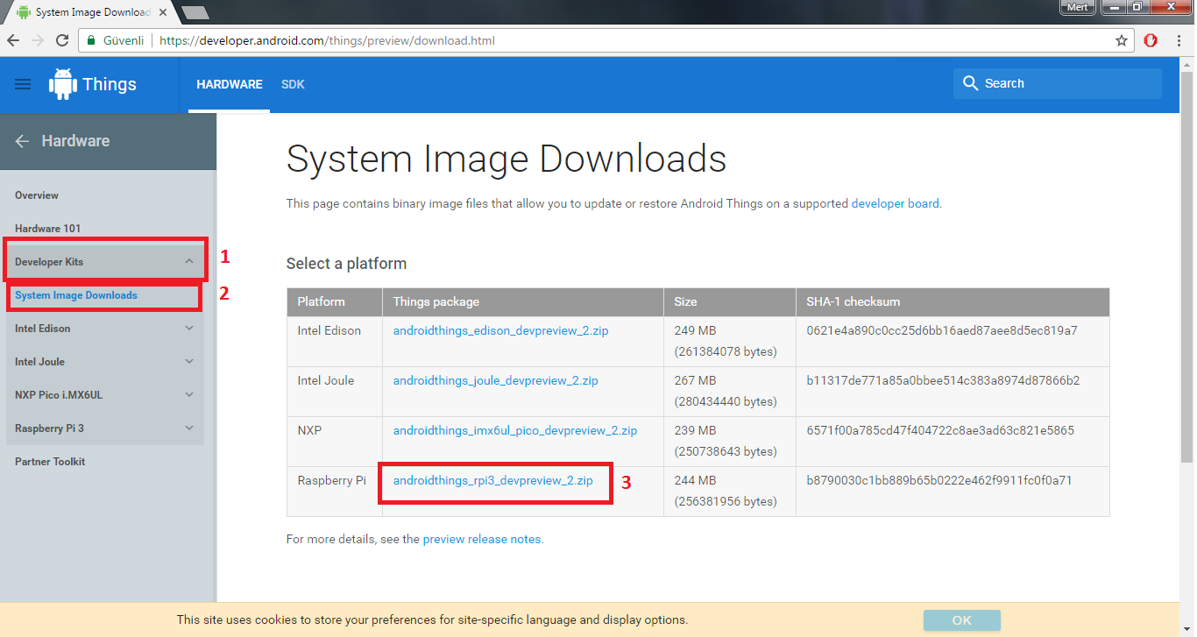
Installing Android Things
Download system image from https://developer.android.com/things/preview/download.html

Slide 14
Installing Android Things
Download Win32DiskImager from the link below and install it.
https://sourceforge.net/projects/win32diskimager/
This program is capable of flashing Android Things “.img” file to Micro SD-Card.

Slide 15
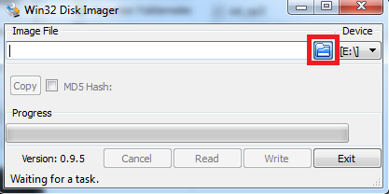
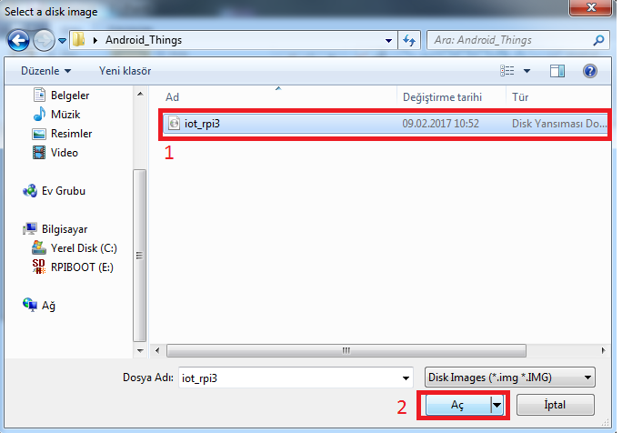
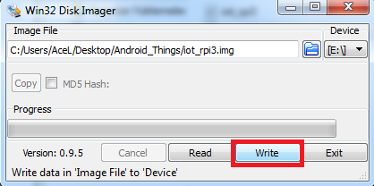
Installing Android Things
Click button to select file. | Select file with “.img” extension
Click “Write” button to flash image.

Slide 16
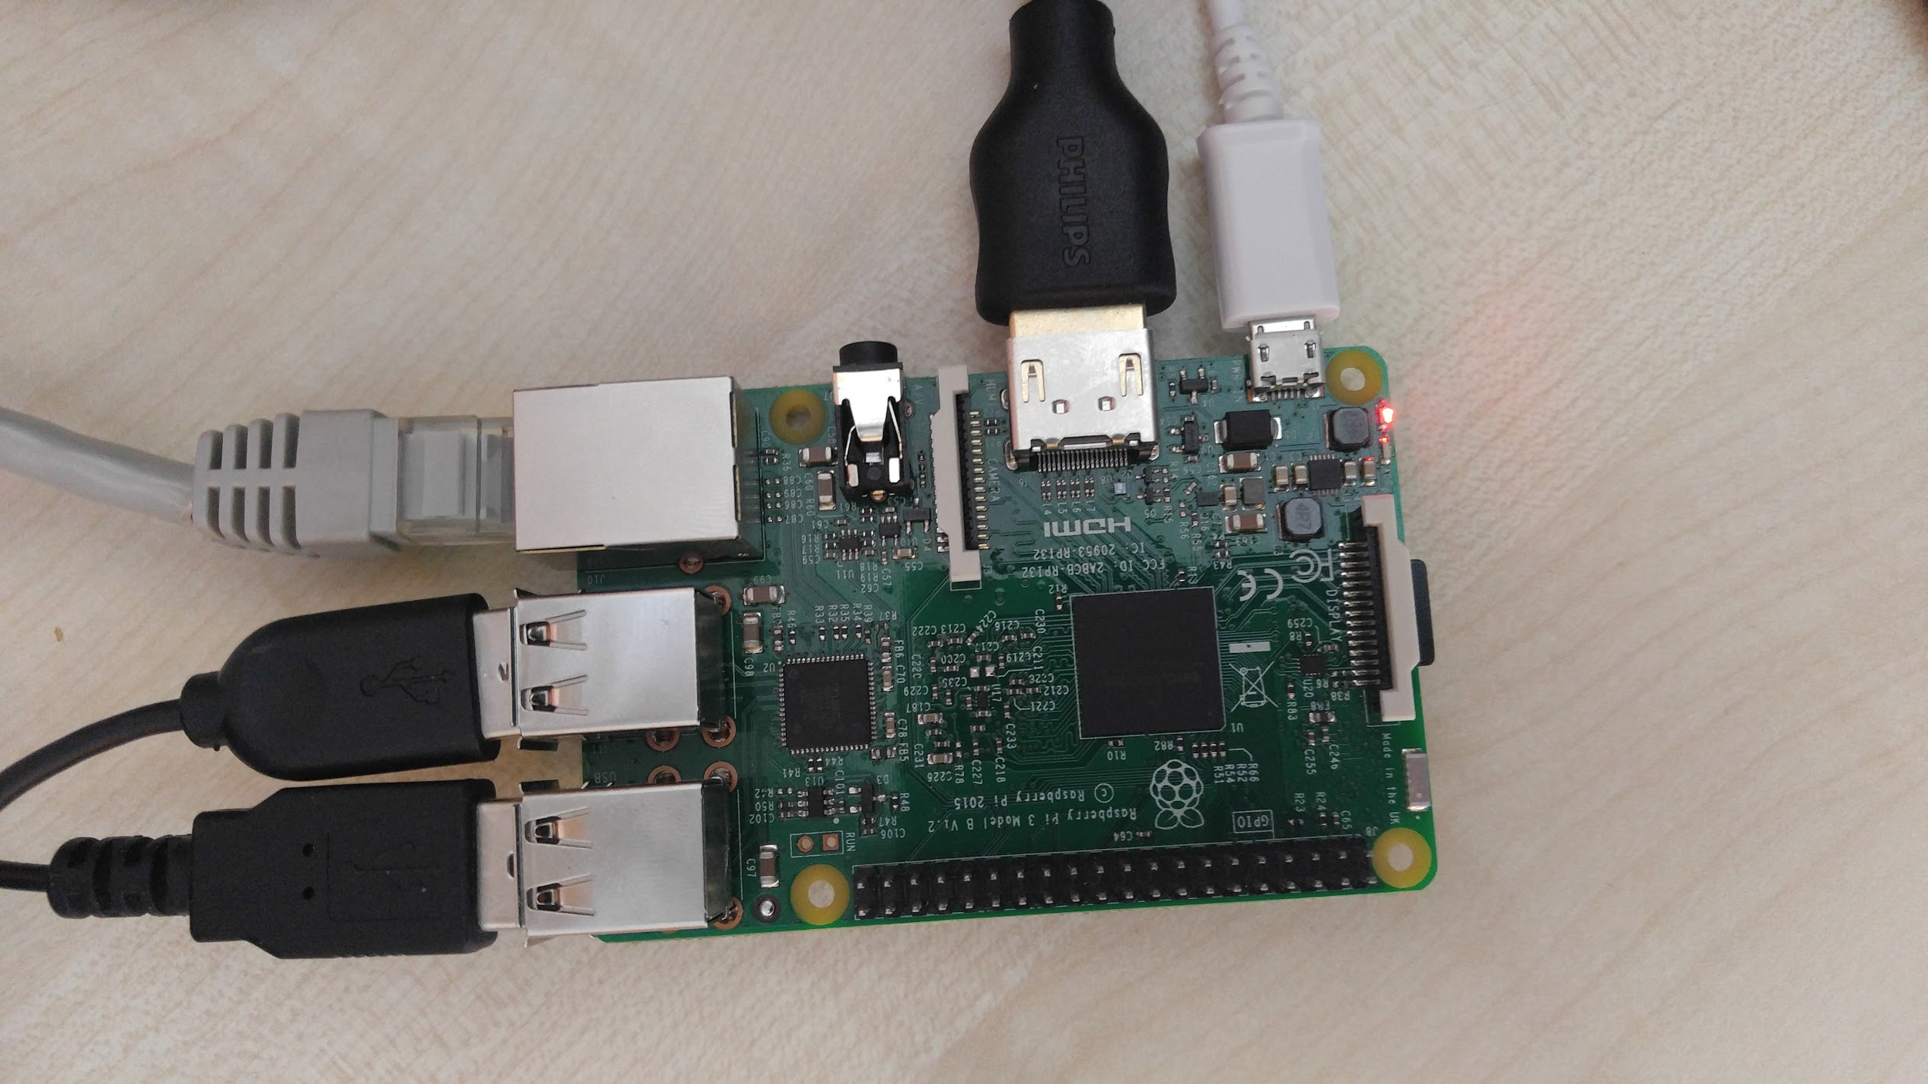
Installing Android Things
Insert flashed SD-Card to Raspberry Pi

Slide 17
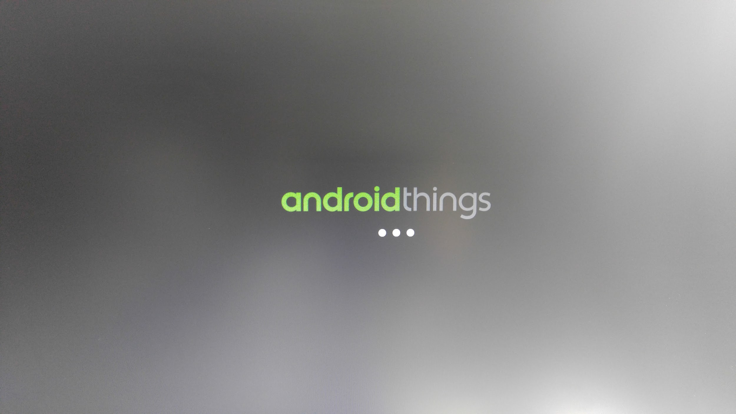
Installing Android Things
Power up Raspberry Pi. You should see the boot up screen below.

Slide 18
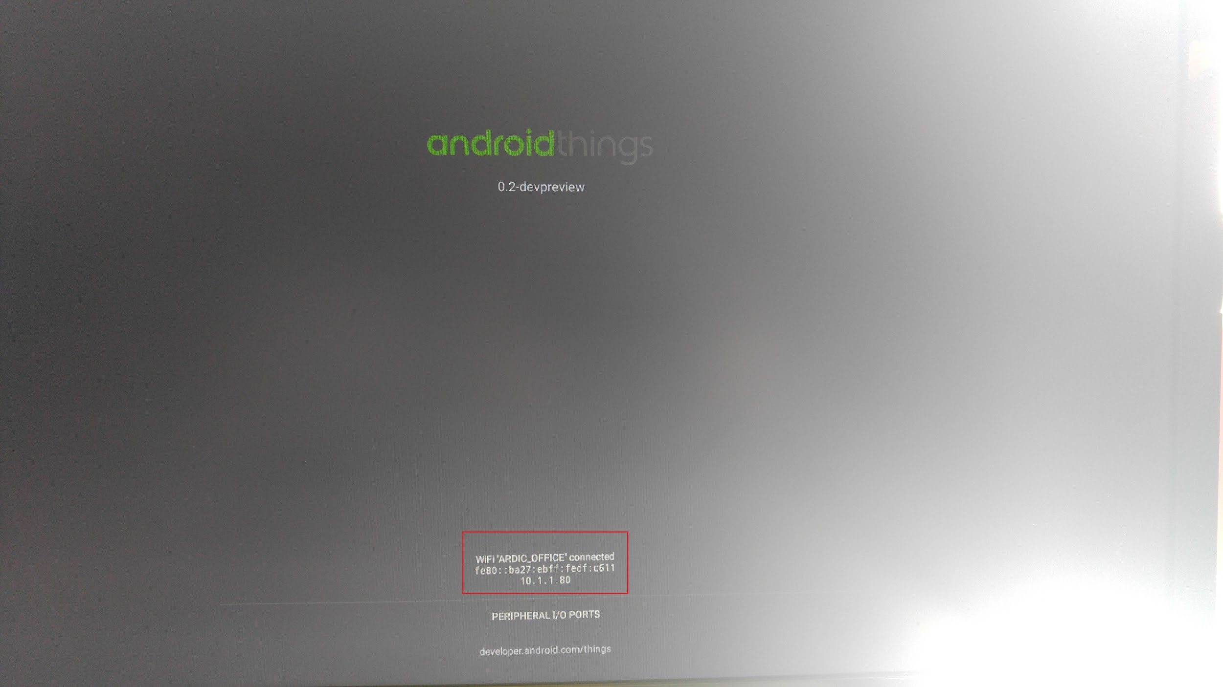
Installing Android Things
Using the displayed IP at the bottom of this screen, we can connect to and configure this device. We are going to use “adb” application for this purpose.

Slide 19
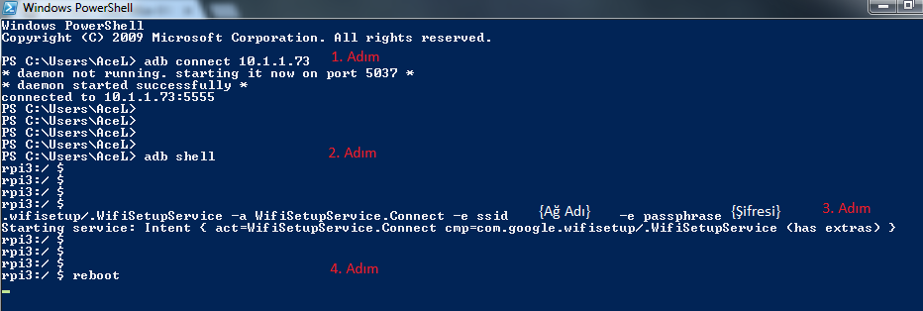
Installing Android Things
am startservice -n com.google.wifisetup/.WifiSetupService -a WifiSetupService.Connect -e ssid <SSID> -e passphrase <PASSWD>
1st Step
2nd Step
3rd Step
4th Step

Slide 20
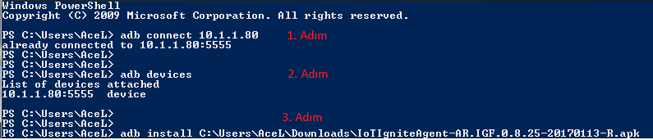
Installation of IoT-Ignite Agent & Licensing Gateway
1st Step
2nd Step
3rd Step

Slide 21
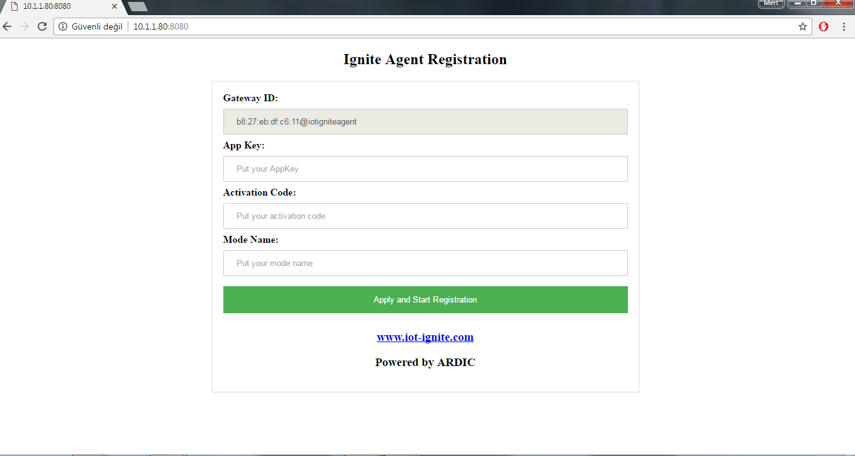
Installation of IoT-Ignite Agent & Licensing Gateway
After you connect to the same network, open a web browser and enter <Gateway IP>:8080.

Slide 22
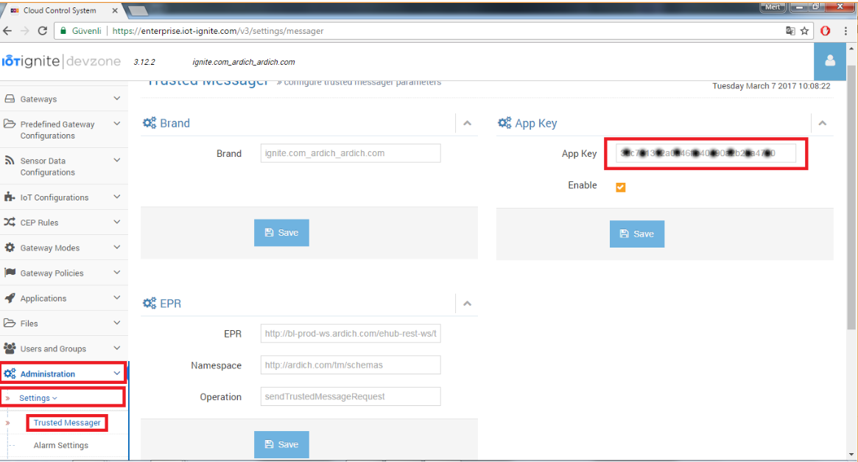
Installation of IoT-Ignite Agent & Licensing Gateway
How to obtain application key:

Slide 23
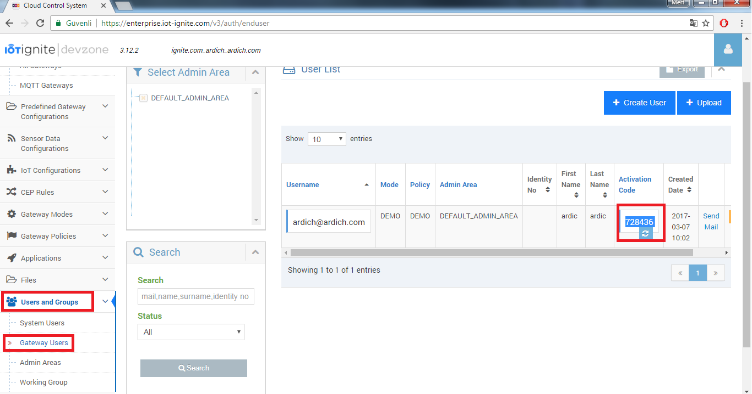
Installation of IoT-Ignite Agent & Licensing Gateway
How to retrieve activation code:

Slide 24
Installation of IoT-Ignite Agent & Licensing Gateway
Mode Name:
This step is optional. If skipped, gateway is switched to default mode. If you want your gateway to be switched to another mode, you can enter that mode name during licensing process.

Slide 25
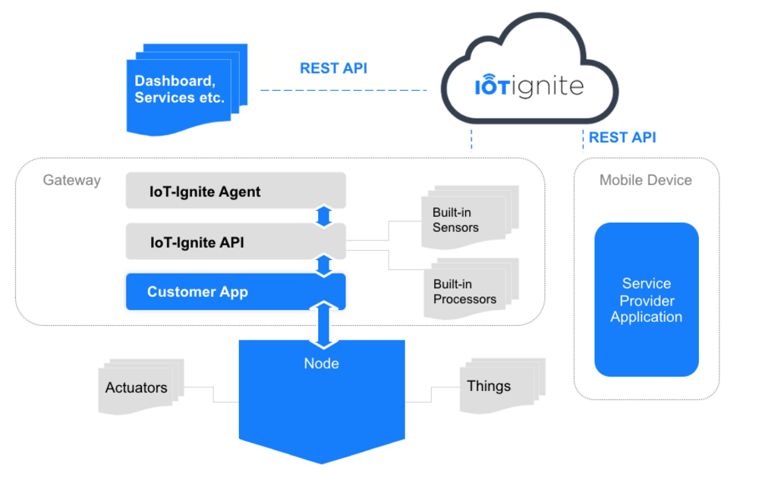

Slide 26
Smart Weather Station
Using BME280 sensor and Android Things I2C interface, send data to IoT-Ignite Cloud.
Write a rule on pressure or temperature and twit it.

Slide 27
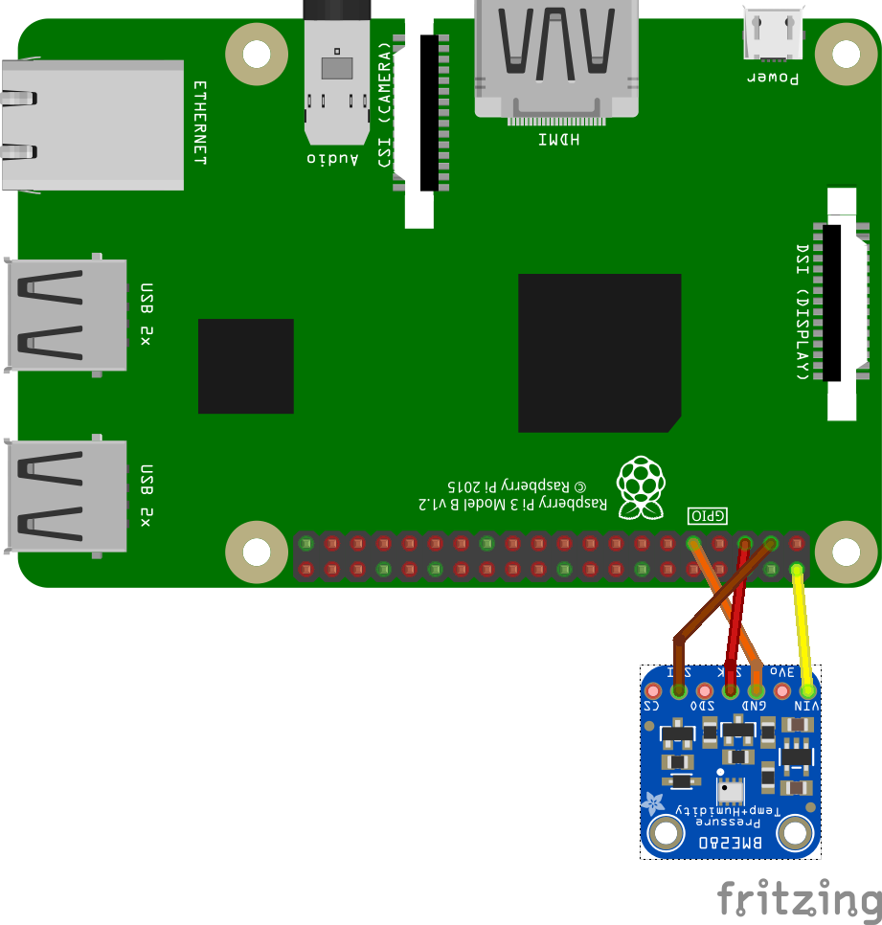
Smart Weather
Station

Slide 28
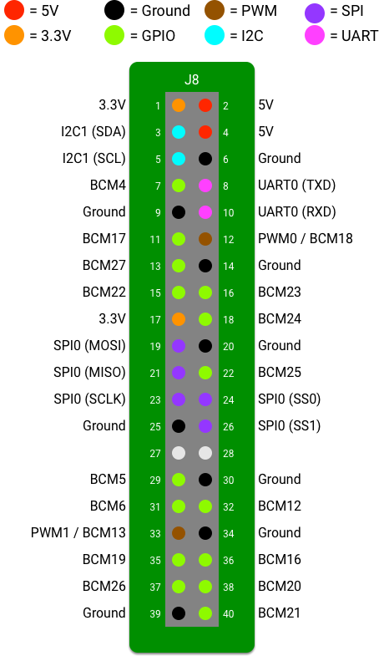
Raspberry Pi 3 PinOut

Slide 29
References
https://developer.android.com/things/sdk/index.html
https://devzone.iot-ignite.com/documents/
https://github.com/IoT-Ignite
https://github.com/androidthings
https://github.com/androidthings/contrib-drivers

